Slide 1
BIG DATA
Sandeep Kumar Bhandoria
sandeepkbh47@gmail.com
NIIT, Janakpuri, Delhi

Slide 2
Outline
Introduction
What is Big Data?
Why BIG DATA?
4v’s And Type of “BIGDATA”
When Big-Data is really a problem?
Prerequisites
Hadoop
Daily Achievement
Technology Used
Concepts
GITHUB

Slide 3
What is BIG DATA
BIG DATA is extreme volume of data both structured, semi structured and unstructured data .
BIG DATA is often characterized by 4v’s volume, variety, veracity, velocity.

Slide 4
WHY BIG DATA
Key for the growth of “Big DATA”
Increase need to storage capacities
Increase processing power
Availability of data

Slide 5
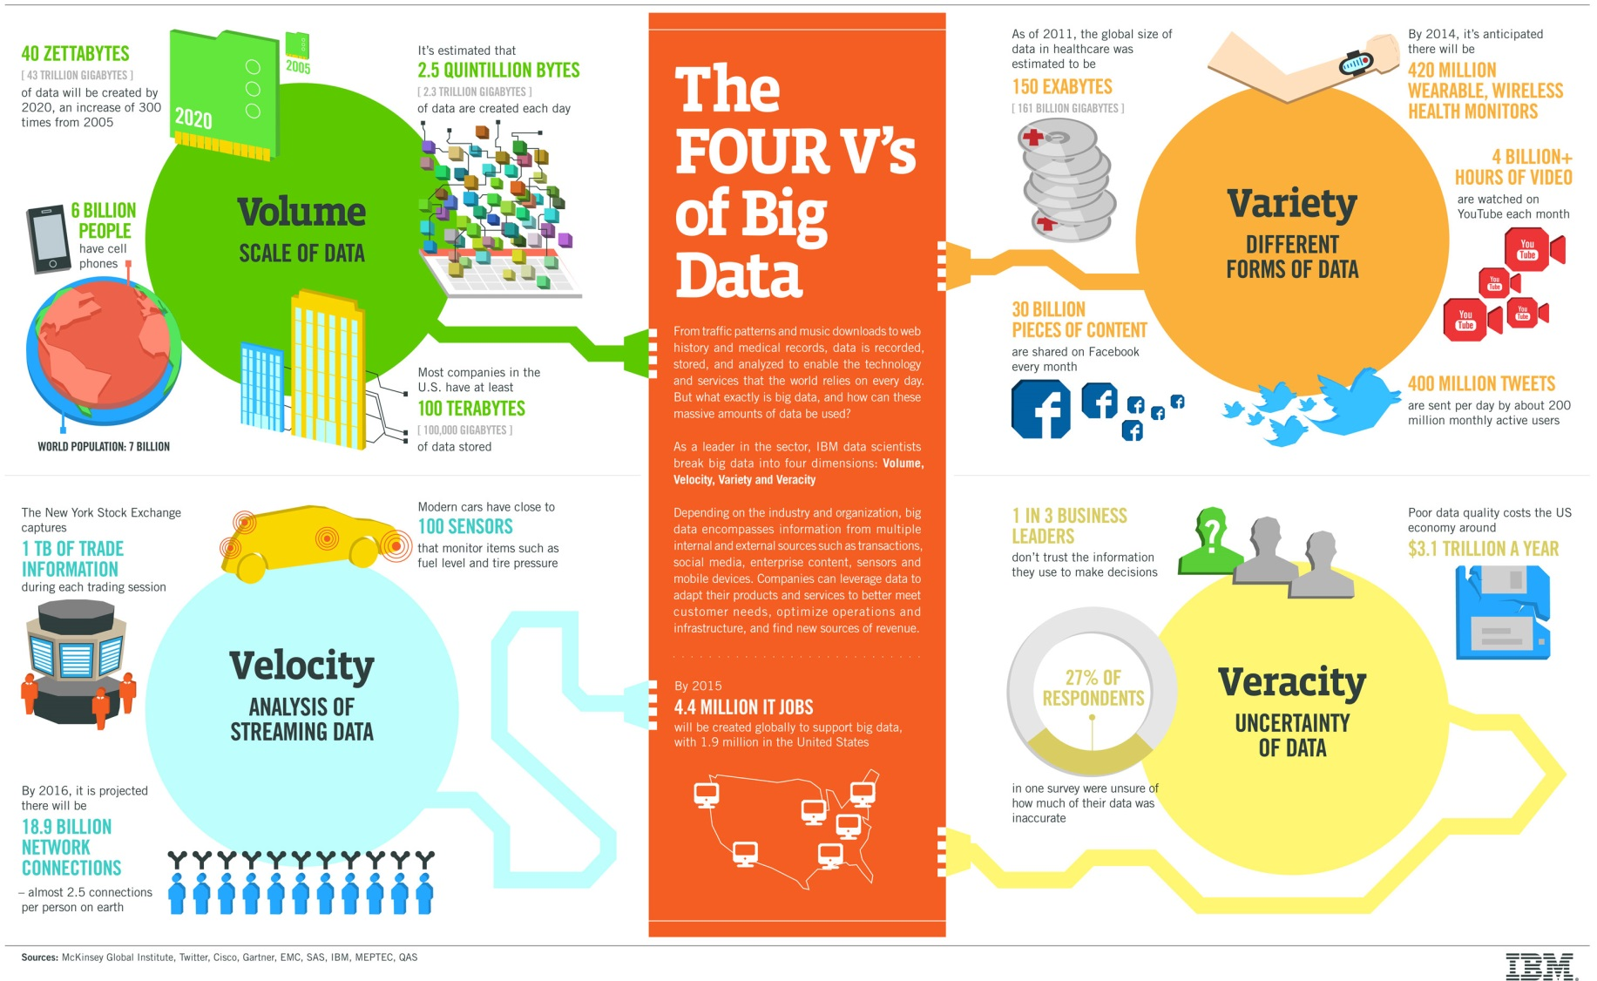
4v’s of BIG DATA

Slide 6
4v’s of BIG DATA
Volume-Defines the extreme amount of data.
Velocity- Defines the data that keeps on changing.
Veracity-Accuracy of data
Variety-Different forms of data such as Structured and semi-structured and unstructured.

Slide 7
Type of Data is BIG DATA
SOCIAL NETWORKING DATA
GPS LOCATION DATA
SHOPPING HABBITS
SERACH PATTERNS
ONLINE INTERESTS

Slide 8
PROBLEMS ASSOCIATED WITH BIG DATA
PHYSICAL PROBLEMS
PROCESSING PROBLEMS
INCORRECT DATA
LARGE AMOUNT OF COST SPENT BY SMALL BUSINESS

Slide 9
Pre-Requisite for Big DATA
Java Essential
OOPs Concept
Conditional constructs such as If Else Switch
Access specifier- private, protected, default and public.
Functions
Constructors
Exception Handling

Slide 10
Pre-Requisite for Big DATA continued…
Collections –Maps, Sets and List
Generics
SQL Queries
Create table
Insert into table
Update a table(rows)
Delete a row
File Handling
J2EE- Servlet, JSP, HTML

Slide 11
J2EE Web Based Application (14/11/2016)
Web application using Eclipse IDE
SERVLET
HTML
JSP

Slide 12
Hadoop(15/11/2016)
Hadoop is an Apache open source, Java-based programming framework that supports the processing and storage of extremely large data sets in a distributed computing environment.
Hadoop and Big Data Understanding
4v’s Hadoop Big Data
Hadoop 1.x and 2.x architecture
Daily Quiz and Mocks

Slide 13
VM Box and Hadoop Installation(16/11/2016)
Installation of virtual box.
Installation of Putty and Winscp.
Importing Image in VM
RAM, Network, Intel-Virtualization check and some basic troubleshooting.
Basic Linux Commands
Installing Hadoop 2.7.1
Starting, Stopping and verifying Hadoop services.

Slide 14
MapReduce Application Creation(17/11/2016)
Simple Map reduce programs
No reducer programs
Mapper and Reducer Programmer
Combiner
Word COUNT Example

Slide 15
Map-Side and Reducer Side Join & InputFormat Program (18-19/11/2016
Map Side join ask
Reducer Side Join tasks.
Creating custom Input Format
Daily QUIZ

Slide 16
More Task on MapReduce and Custom InputFormat(20/11/2016)
More Task on Map Side Join
More Task on reducer side join
Creating our own Custom InputFormat

Slide 17
Project 1 Task and Documentation plus HIVE Basic (21/11/2016)
Project Related Task
Some More example in Map Side Join
Basic Hive Query
Daily QUIZ

Slide 18
Project Documentation and Transaction (22/11/2016)
Worked on Project Documentation
Server Log Task

Slide 19
PIG and HIVE(23-24/11/16)
PIG INTRO
PIG TASKS
HIVE Complex Query Tasks
GITHUB Maintenance
Project 1 Ecommerce Documentation

Slide 20
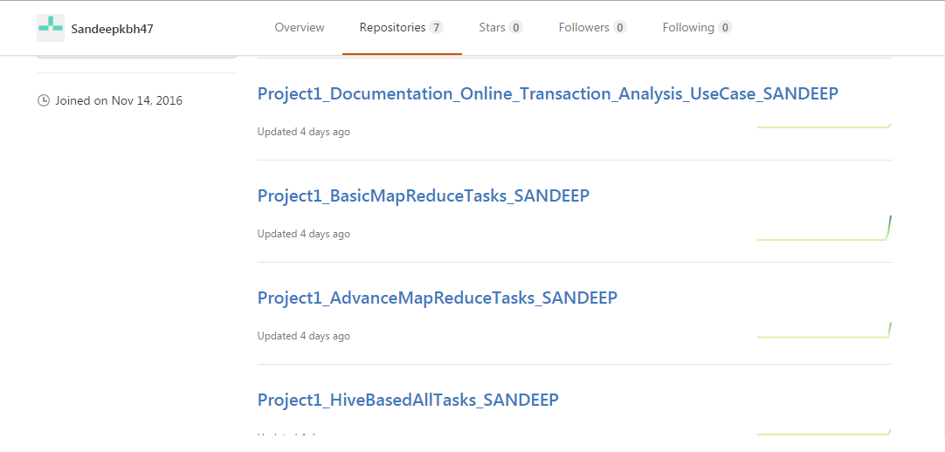
GITHUB Maintenance

Slide 21
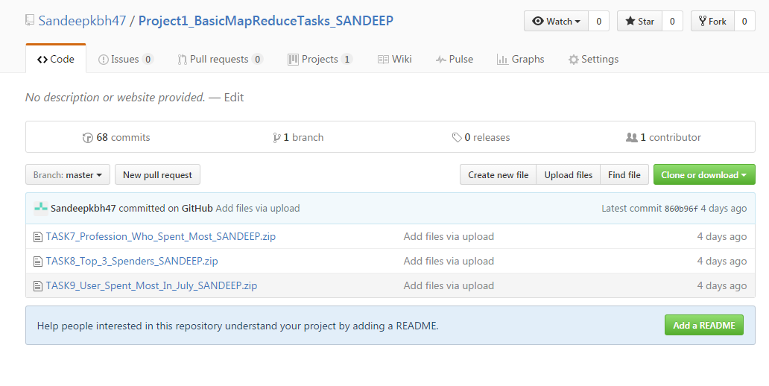
GITHUB Maintenance

Slide 22
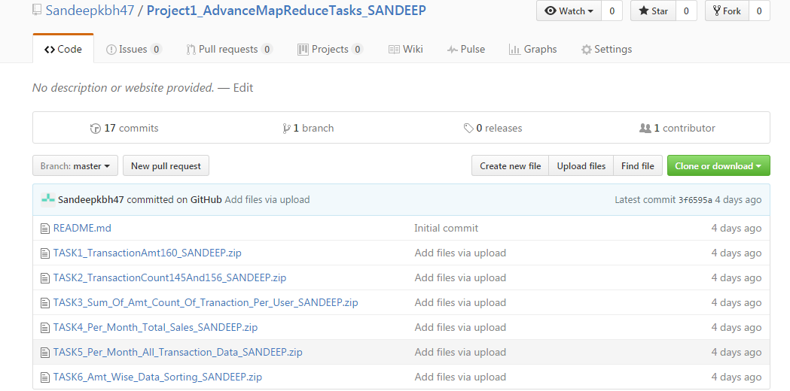
GITHUB Maintenance

Slide 23
SQOOP, DAILY QUIZ, ZOOKEEPER(25/11/16)
Introduction to SQOOP
SQOOP Tasks
Mocks On new Ecosystem tools.

Slide 24
Intro to OOZIE(28/11/2016)
Intro to OOZIE
Project 2 Advance MR jobs
Project 2 Documentation.

Slide 25
Hadoop Ecosystem components we learnt
Apache HDFS
Apache MapReduce
Apache HIVE
Apache PIG
Apache SQOOP
Others
Oracle MySQL database

Slide 26
Apache HDFS and Map Reduce
Apache HDFS (Hadoop Distributed File System) is a distributed file system designed to run on commodity hardware.
Hadoop MapReduce is a software framework for easily writing applications which process vast amounts of data. It enables parallel processing on large clusters (thousands of nodes) of commodity hardware in a reliable, fault-tolerant manner.

Slide 27
Apache HIVE and PIG
Apache HIVE is a data warehouse built on top of Hadoop for reading, writing, and managing large datasets residing in HDFS using SQL (HIVEQL
Pig is a scripting language for creating program that run on top of Apache Hadoop.

Slide 28
Apache SQOOP and ORACLE MySQL
Apache SQOOP is a tool designed for importing and exporting data from and to a RDBMS databases.
MySQL, is a Open Source SQL database management system, is developed, distributed, and supported by Oracle Corporation.

Slide 29
Concepts we learnt
Simple Map Reduce Java Project
Mapper
Combiner
Partitioner
Reducer
Advance Map Reduce Java Project
Simple Map Reduce app plus
Custom InputFormat
RecordReader
Map-Side Join
Reducer-Side Join

Slide 30
Concepts we learnt
HIVE
Create table
Load data
Export data
PIG
LOAD data
FILTER data
GROUP data
JOIN data
DUMP AND STORE data
MySQL
SQOOP
Import data from RDBMS
Export data to RDBMS

Slide 31
Project 1 E-Commerce Online Transaction Analysis
BACKGROUND - I am a Hadoop Developer.
OBJECTIVE – Project is based on real time analysis of a online transaction data given by one of our client company. This Ecommerce project gathers some facts like
how much monthly revenue company is generating?
What is his top selling products?
Who are the Top customers?
Profession who is most affected by their Products?

Slide 32
Project 1 E-Commerce Online Transaction Analysis
TECHNOLOGY USED-
Apache Hadoop
Map Reduce Programming
HIVE
PIG
SOFTWARE USED-
Virtual Box
Eclipse
Ubuntu

Slide 33
PROJECT 2 GLOBAL EMPLOYABILITY & EDUCATIONAL ANALYSIS
OBJECTIVE
The main objective of this project was to come up with relevant information for
New IT Sector companies,
New Matrimonial Sites,
Global Education Status ,
Ratio of native born and immigrants people,
New Policies for Widow and Divorce and Senior Citizen
Creating Election Port-Folio

Slide 34
PROJECT 2 GLOBAL EMPLOYABILITY & EDUCATIONAL ANALYSIS
TECHNOLOGY USED
Apache Hadoop HDFS
Apache Hadoop Map Reduce
Apache HIVE
Apache SQOOP
Apache PIG

Slide 35
PROJECT 2 GLOBAL EMPLOYABILITY & EDUCATIONAL ANALYSIS
SOFTWARE USED
Virtual Box
Eclipse
Ubuntu
Cloudera

Slide 36
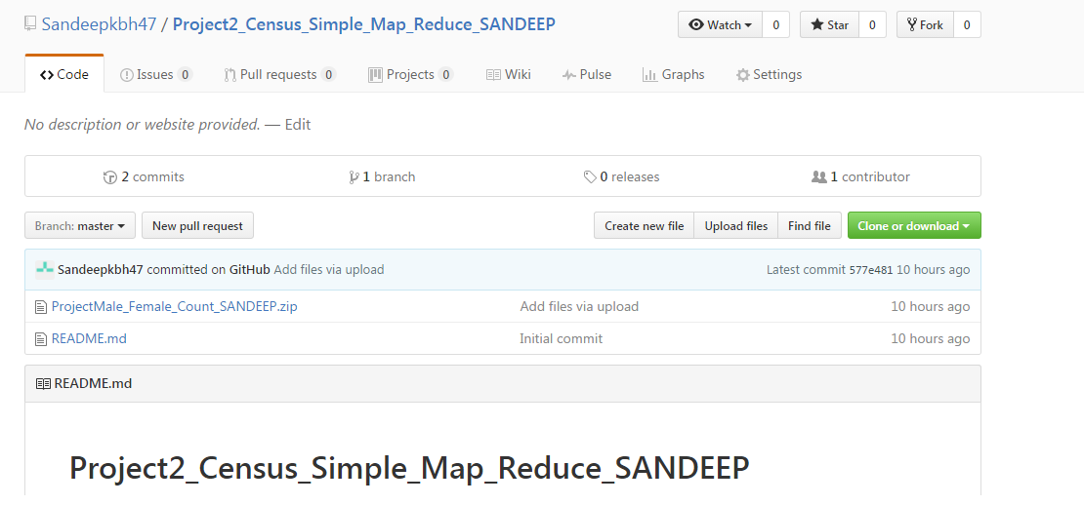
GITHUB Maintenance Project 2

Slide 37
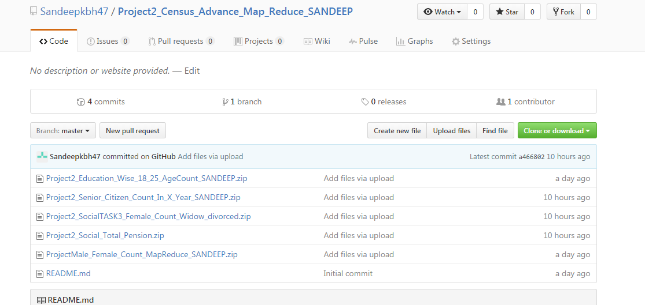
GITHUB Maintenance Project 2

Slide 38
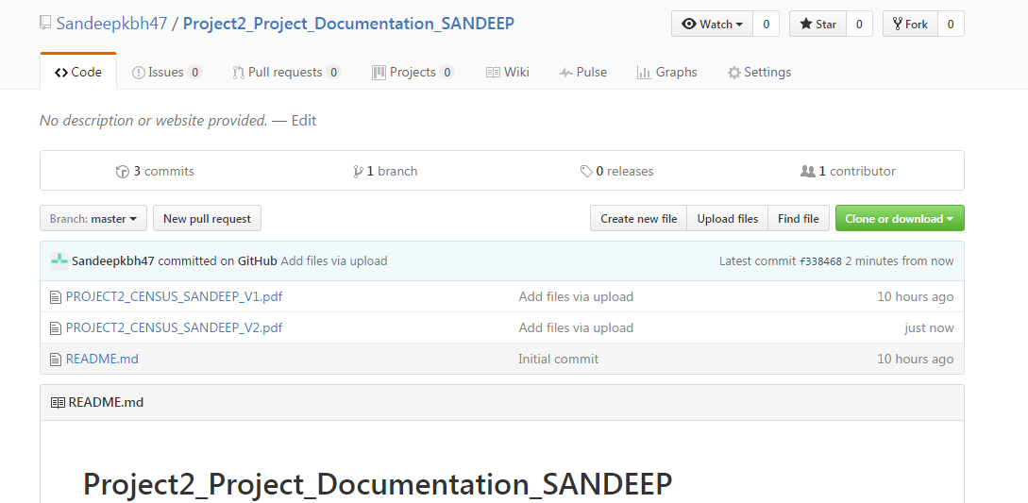
GITHUB Maintenance Project 2

Slide 39
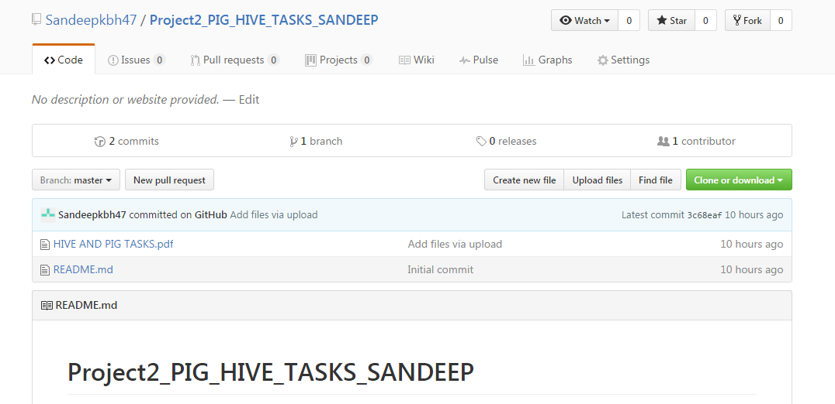
GITHUB Maintenance Project 2

Slide 40
THANK YOU

